Slide 1

Bike Availability in Washington DC
Clare Cruz
Tristal Li
Zhuoheng Han
Wei-Yu Tseng

Slide 2
Executive summary
Bike availability:

Slide 3
Data Description

Slide 5
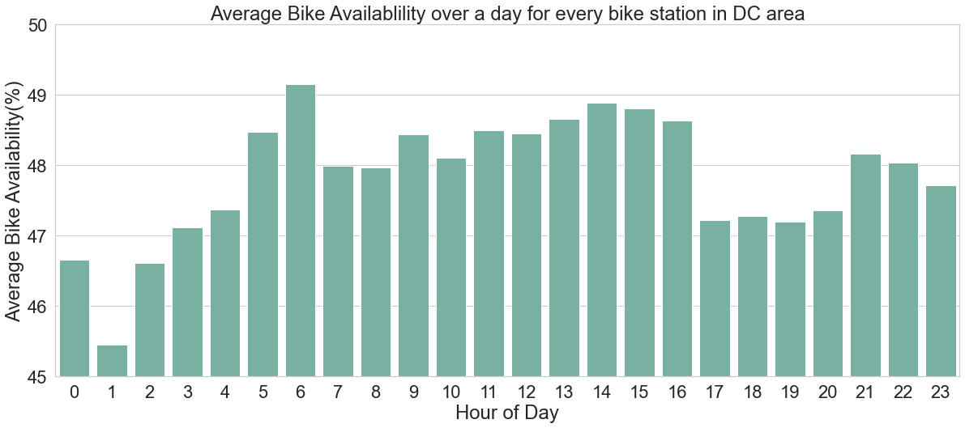
Overall Bike Availability in a Day

Slide 6
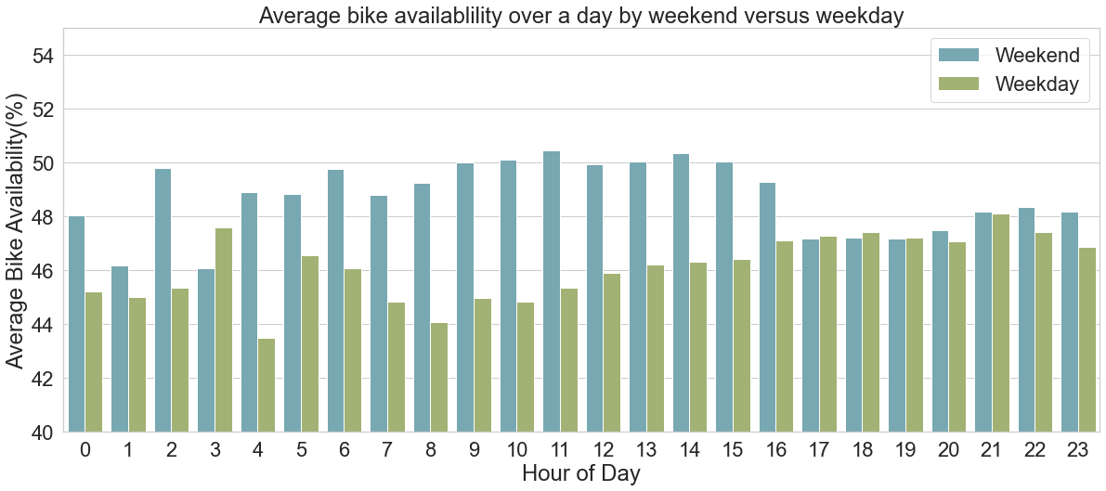
Weekday vs. Weekend

Slide 7
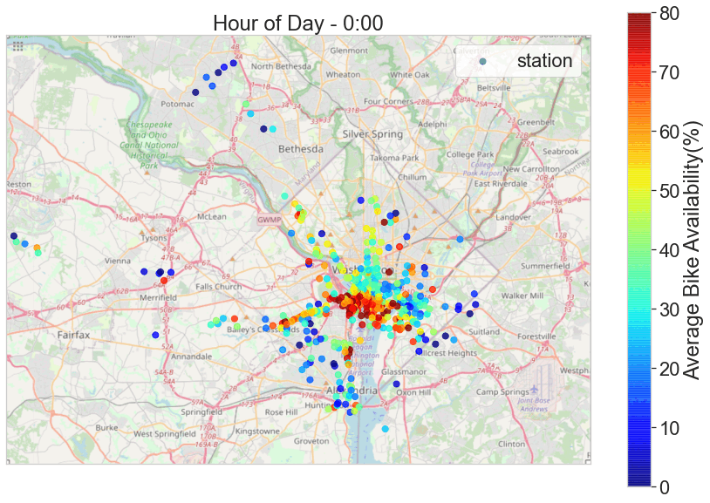
Bike Availability in Washington DC

Slide 8
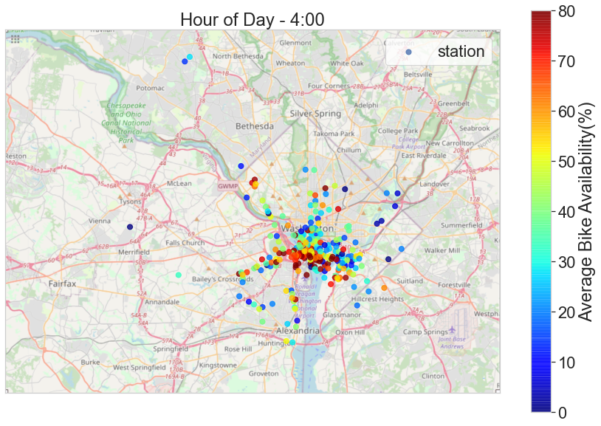
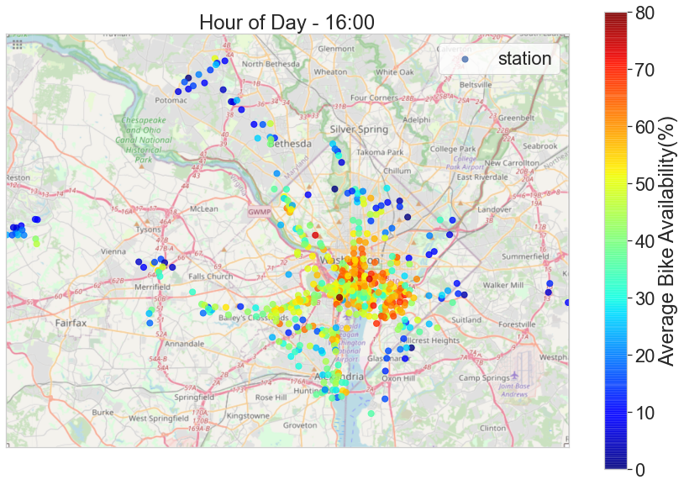
Non-working vs. Working Hours

